Slide 1


UNIVERSITY OF
CALIFORNIA

Slide 2
User name: acf-guest
Password: Illinois123
Please use Chrome
Teaching materials for today:
https://uofi.box.com/webapollo

Slide 3

An introduction to Web Apollo. Manual Annotation Workshop at UIUC
UNIVERSITY OF
CALIFORNIA
Monica Munoz-Torres, PhD | @monimunozto
Berkeley Bioinformatics Open-Source Projects (BBOP)
Genomics Division, Lawrence Berkeley National Laboratory
11 June, 2014

Slide 4
Outline
What is Web Apollo?:
Definition & working concept.
Our Experience With Community Based Curation.
The Thought Process Behind Manual Annotation.
Becoming Acquainted With Web Apollo.
Demonstration and Exercises.
An introduction to Web Apollo. Manual Annotation Workshop at UIUC

Slide 5
During this workshop you will:
Learn to identify homologs of known genes of interest in your newly sequenced genome.
Become familiar with the environment and functionality of the Web Apollo genome annotation editing tool.
Learn how to corroborate and / or modify automatically annotated gene models using all available evidence in Web Apollo.
Understand the process of curation in the context of genome annotation: from the assembled genome sequence to manual curation via automated annotation, among other things.

Slide 6
During this lecture I invite you to:
Observe and detail the figures
Listen to the explanations
Interrupt me at any time to ask questions
Use Twitter & share your thoughts: I am @monimunozto A few suggested tags & users: #WebApollo #Annotation #Curation #GMOD #HPCBio #HoneyBee #genome @JBrowseGossip
Take brakes: LBL’s ergo safety team suggests I should not work at the computer for >45 minutes without a break; neither should you! We will be here for 2.5 hours: please get up and stretch your neck, arms, and legs as often as you need.

Slide 7
During this lecture I kindly ask that you refrain from:
Reading all that text I wrote! – Think of the text on these slides as your “class notes”. You will use them during exercises.
Checking email – I’d like to kindly ask for your undivided attention.

Slide 8
Let Us Get Started

Slide 9
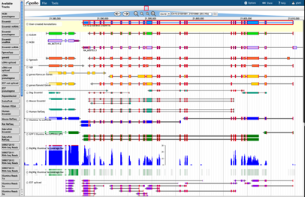

What is Web Apollo?
Web Apollo is a web-based, collaborative genomic annotation editing platform.
We need annotation editing tools to modify and refine the precise location and structure of the genome elements that predictive algorithms cannot yet resolve automatically.
Find more about Web Apollo at http://GenomeArchitect.org and Genome Biol 14:R93. (2013).

Slide 10

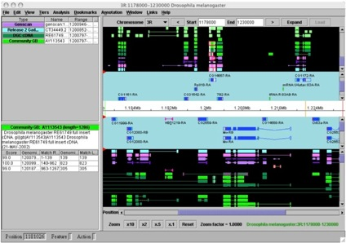
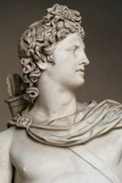
Brief history of Apollo*:
Biologists could finally visualize computational analyses and experimental evidence from genomic features and build manually-curated consensus gene structures. Apollo became a very popular, open source tool (insects, fish, mammals, birds, etc.).
a. Desktop: one person at a time editing a specific region, annotations saved in local files; slowed down collaboration.
b. Java Web Start: users saved annotations directly to a centralized database; potential issues with stale annotation data remained.
*

Slide 11
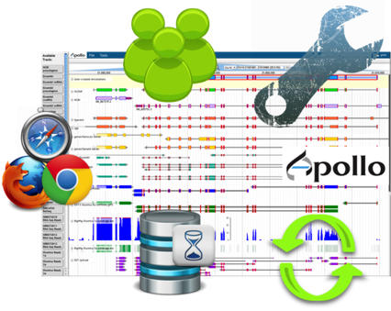
Web Apollo
Browser-based tool integrated with JBrowse.
Two new tracks: “Annotation” and “DNA Sequence”
Allows for intuitive annotation creation and editing, with gestures and pull-down menus to create and modify transcripts and exons structures, insert comments (CV, freeform text), etc.
Customizable look & feel.
Edits in one client are instantly pushed to all other clients: Collaborative!

Slide 12


Web Apollo
Provides dynamic access to genomic analysis results from both UCSC and Chado databases as well as database storage of user-created annotations. All user-created sequence annotations are automatically uploaded to a server, ensuring reliability.
Chado
UCSC (MySQL)
Ensembl (DAS)
BAM
BED
BigWig
GFF3
MAKER output

Slide 13







Web Apollo Architecture
Annotators
- BAM - BigWig - GFF3 - VCF*
User Interface (JavaScript)
Apollo Edit Operations & User Management
JSON
JBrowse
Web Apollo
Server-side Data Service
Annotation Editing Engine (Java)
Static JSON Generation Pipeline (Perl)
Trellis Data Broker (Java)
Berkeley DB realtime store
User Management
Data Sources
Analysis Pipelines
Data Repositories
Annotation Exports
- BAM
- BED
- BigWig
- GFF3
Chado
- MAKER output
MySQL
- GFF3 - FASTA
DAS servers e.g. Ensembl
Local DB. e.g. Chado
Notes:
Take Home Message:
Annotators can upload their own data.
Data Sources: Analysis Pipelines can process BAM, BED, BigWig, GFF3, and MAKER output without “much” massaging.
Data Repositories:
INNOVATION: Trellis→ A data broker with plug-in architecture for both output formats and back-end data stores.
On the back-end we implemented 3 plug-ins for:
- UCSC MySQL genome database
- Chado
- DAS servers (e.g.: Ensembl)

Slide 14
Working Concept
In the context of gene manual annotation, curation tries to find the best examples and / or eliminate most errors.
To conduct manual annotation efforts:
Gather and evaluate all available evidence using quality-control metrics to corroborate or modify automated annotation predictions.
Perform sequence similarity searches (phylogenetic framework) and use literature and public databases to:
Predict functional assignments from experimental data.
Distinguish orthologs from paralogs, and classify gene membership in families and networks.
Automated gene models
Evidence:
cDNAs, HMM domain searches, alignments with assemblies or genes from other species.
Manual annotation & curation

Slide 15


Dispersed, community-based gene manual annotation efforts.
We continuously train and support hundreds of geographically dispersed scientists from many research communities, to perform biologically supported manual annotations using Web Apollo.
Gate keepers and monitoring.
Written tutorials.
Training workshops and geneborees.
Personalized user support.

Slide 16
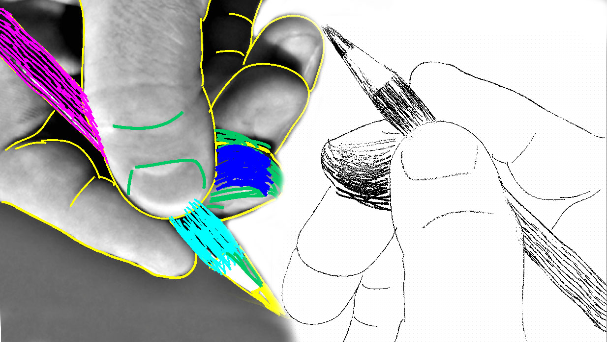
What we have learned.
Harvesting expertise from dispersed researchers who assigned functions to predicted and curated peptides we have developed more interactive and responsive tools, as well as better visualization, editing, and analysis capabilities.
http://people.csail.mit.edu/fredo/PUBLI/Drawing/

Slide 17
Collaborative Efforts Improved Automated Annotations*
In many cases, automated annotations have been improved (e.g: Apis mellifera. Elsik et al. BMC Genomics 2014, 15:86).
Also, learned of the challenges of newer sequencing technologies, e.g.:
Frameshifts and indel errors
Split genes across scaffolds
Highly repetitive sequences
To face these challenges, we train annotators in recovering coding sequences in agreement with all available biological evidence.

Slide 18

It is helpful to work together.
Scientific community efforts bring together domain-specific and natural history expertise that would otherwise remain disconnected.
Breaking down large amounts of data into manageable portions and mobilizing groups of researchers to extract the most accurate representation of the biology from all available data distills invaluable knowledge from genome analysis.

Slide 19
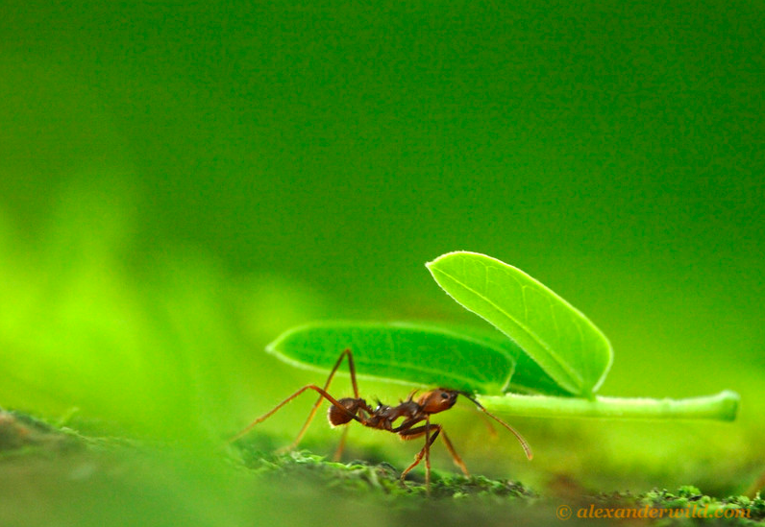
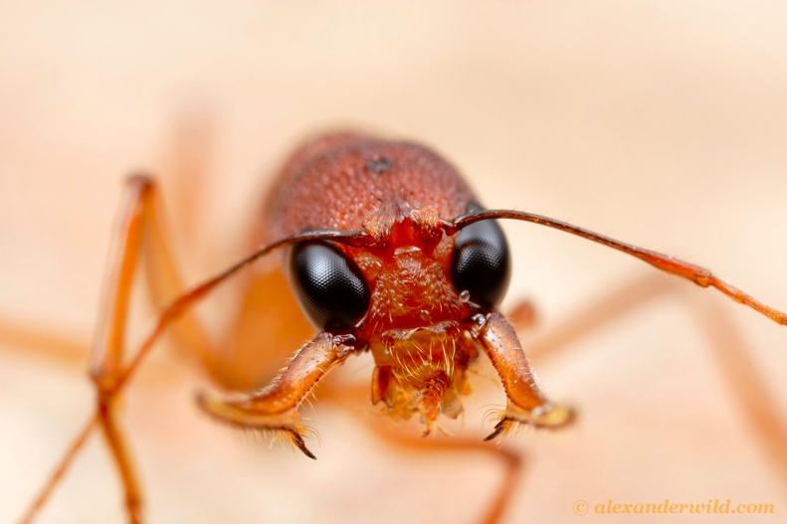
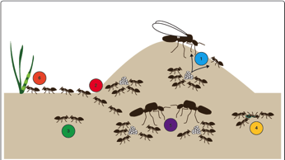
Groups of communities continue to guide our efforts.
Understanding the evolution of sociality
Comparing the genomes of 7 species of ants contributed to a better understanding of the evolution and organization of insect societies at the molecular level.
Insights drawn mainly from six core aspects of ant biology:
Alternative morphological castes
Division of labor
Chemical Communication
Alternative social organization
Social immunity
Mutualism
Atta cephalotes (above) and Harpegnathos saltator. ©alexanderwild.com
Libbrecht et al. 2012. Genome Biology 2013, 14:212

Slide 20


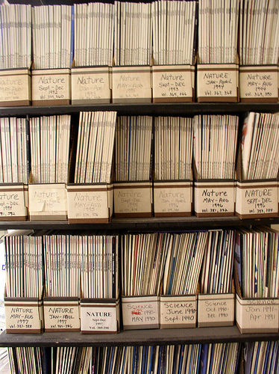

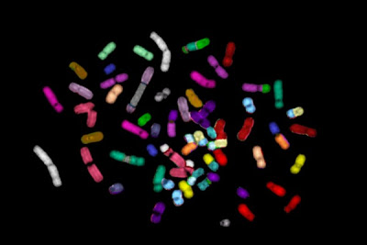
A little training goes a long way!
With the right tools, wet lab scientists make exceptional curators who can easily learn to maximize the generation of accurate, biologically supported gene models.

Slide 21

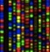
Manual Annotation
How do we get there?
Q-ratore
Automated Annotation
Manual annotation
Experimental validation
Assembly
In a genome sequencing project…

Slide 22
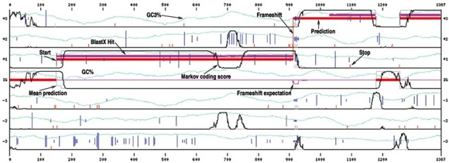
Gene Prediction
Identification of protein-coding genes, tRNAs, rRNAs, regulatory motifs, repetitive elements (masked), etc.
- Ab initio (DNA composition): Augustus, GENSCAN, geneid, fgenesh
- Homology-based: E.g: SGP2, fgenesh++
Nucleic Acids 2003 vol. 31 no. 13 3738-3741

Slide 23
Gene Annotation
Integration of data from prediction tools to generate a consensus set of predictions or gene models.
Models may be organized using:
automatic integration of predicted sets; e.g: GLEAN
packaging necessary tools into pipeline; e.g: MAKER
All available biological evidence (e.g. transcriptomes) further informs the annotation process.
In some cases algorithms and metrics used to generate consensus sets may actually reduce the accuracy of the gene’s representation; in such cases it is usually better to use an ab initio model to create a new annotation.

Slide 24
Manual Genome Annotation
Identifies elements that best represent the underlying biology.
Eliminates elements that reflect the systemic errors of automated genome analyses.
Determines functional roles through comparative analysis of well-studied, phylogenetically similar genome elements using literature, databases, and the researcher’s experience.

Slide 25
Curation Process is Necessary
A computationally predicted consensus gene set is generated using multiple lines of evidence.
Manual annotation takes place.
Ideally consensus computational predictions will be integrated with manual annotations to produce an updated Official Gene Set (OGS).
Otherwise, “incorrect and incomplete genome annotations will poison every experiment that uses them”.
- M. Yandell.

Slide 26
Web Apollo

Slide 27
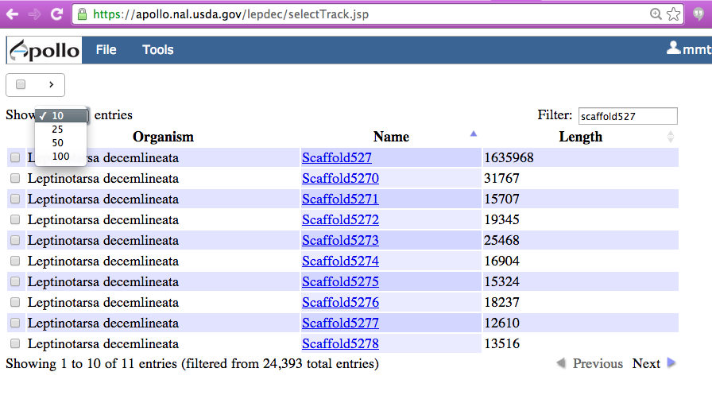

Web Apollo
The Sequence Selection Window
Sort
27

Slide 28
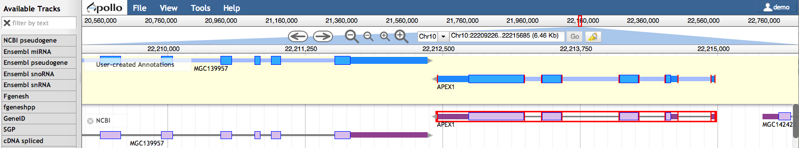

Web Apollo
‘File’: Upload your own evidence: GFF3, BAM, BigWig, VCF*. Add combination and sequence search tracks.
‘Tools’: Use BLAT to query the genome with a protein or DNA sequence.
‘View’: change color by CDS, toggle strands, set highlight.
Grey bar of coordinates indicates location. You can also select here in order to zoom to a sub-region.
Navigation tools: pan and zoom
Search box: go to a scaffold or a gene model.
‘User-created Annotations’ Track
Evidence Tracks Area
Available Tracks
Login
Graphical User Interface (GUI) for editing annotations

Slide 29
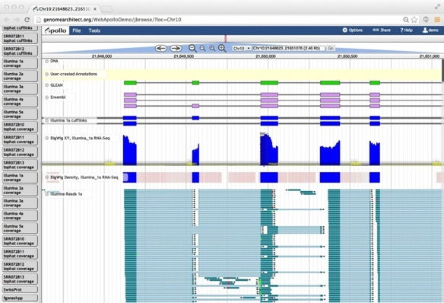
Web Apollo Functionality
In addition to protein-coding gene annotation that you know and love.
Non-coding genes: ncRNAs, miRNAs, repeat regions, and TEs
Sequence alterations (less coverage = more fragmentation)
Visualization of stage and cell-type specific transcription data as coverage plots, heat maps, and alignments
29

Slide 30
General Process of Curation
Select a chromosomal region of interest, e.g. scaffold.
Select appropriate evidence tracks.
Determine whether a feature in an existing evidence track will provide a reasonable gene model to start working.
If yes: select and drag the feature to the ‘User-created Annotations’ area, creating an initial gene model. If necessary use editing functions to adjust the gene model.
If not: let’s talk.
Check your edited gene model for integrity and accuracy by comparing it with available homologs.
Always remember: when annotating gene models using Web Apollo, you are looking at a ‘frozen’ version of the genome assembly and you will not be able to modify the assembly itself.
30

Slide 31
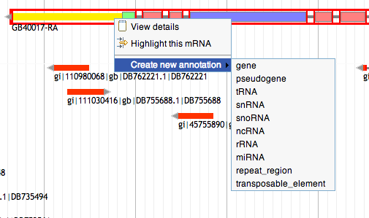
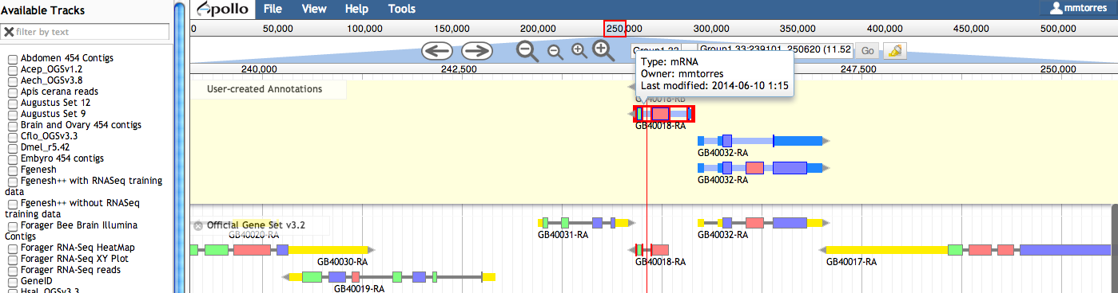
User Navigation
Choose (click or drag) appropriate evidence tracks from the list on the left.
Click on an exon to select it. Double click on an exon or single click on an intron to select the entire gene.
Select & drag any elements from an evidence track into the curation area: these are editable and considered the curated version of the gene. Other options for elements in evidence tracks available from right-click menu.
If you select an exon or a gene, then every track is automatically searched for exons with exactly the same co-ordinates as what you selected. Matching edges are highlighted red.
Hovering over an annotation in progress brings up an information pop-up.
31

Slide 32
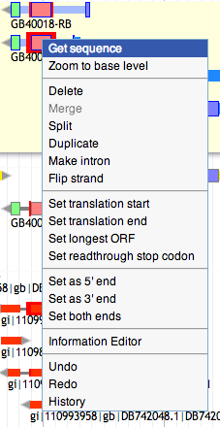
User Navigation
Right-click menu:
With the exception of deleting a model, all edits can be reversed with ‘Undo’ option. ‘Redo’ also available. All changes are immediately saved and available to all users in real time.
‘Get sequence’ retrieves peptide, cDNA, CDS, and genomic sequences.
You can select an exon and select ‘Delete’. You can create an intron, flip the direction, change the start or split the gene.
32

Slide 33
User Navigation
Right-click menu:
If you select two gene models, you can join them using ‘Merge’, and you may also ‘Split’ a model.
You can select ‘Duplicate’, for example to annotate isoforms.
Set translation start, annotate selenocysteine-containing proteins, match edges of annotation to those of evidence tracks.
33

Slide 34
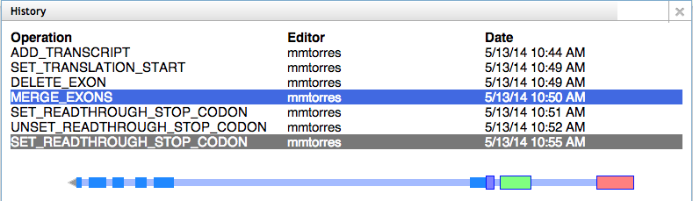
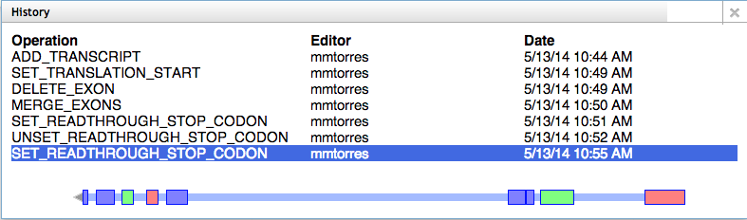
User Navigation
Annotations, annotation edits, and History: stored in a centralized database.
34

Slide 35
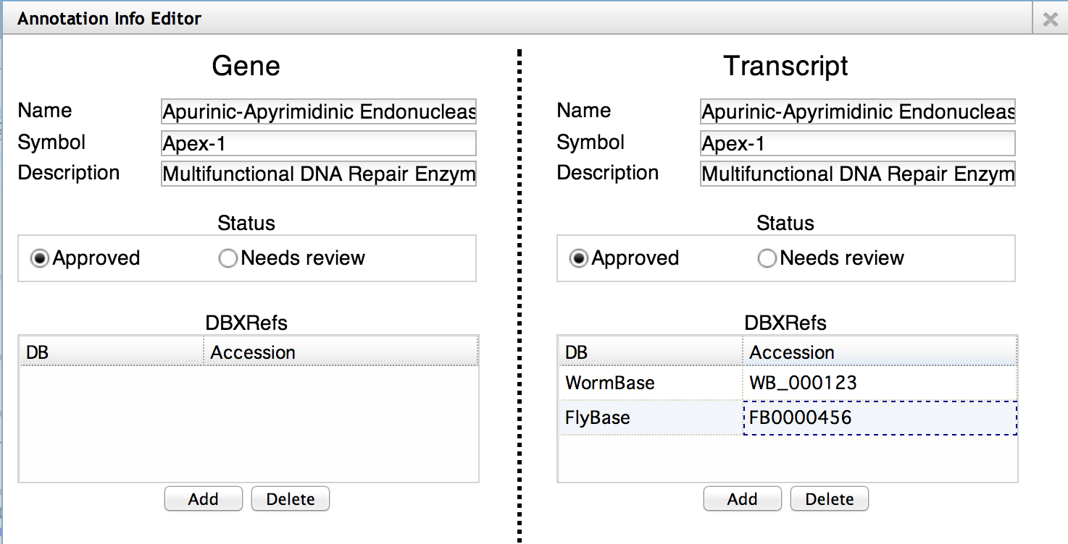
User Navigation
The Annotation Information Editor
DBXRefs are database crossreferences: if you have reason to believe that this gene is linked to a gene in a public database (including your own), then add it here.
35

Slide 36
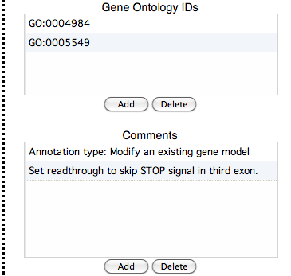
User Navigation
The Annotation Information Editor
Add PubMed IDs
Include GO terms as appropriate from any of the three ontologies
Write comments stating how you have validated each model.
36

Slide 37
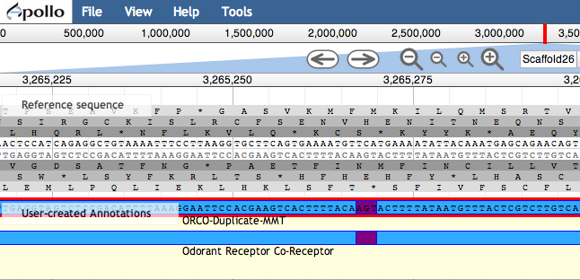
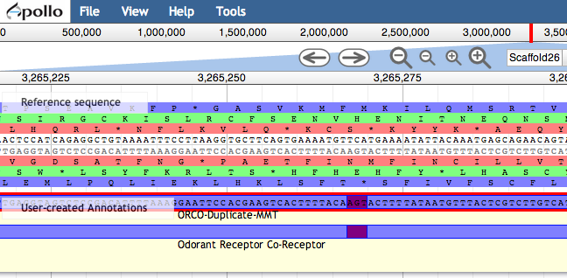
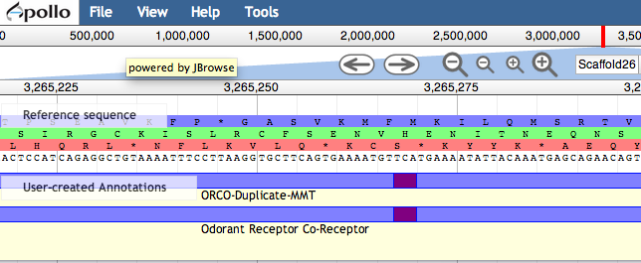
User Navigation
‘Zoom to base level’ option reveals the DNA Track.
Change color of exons by CDS from the ‘View’ menu.
The reference DNA sequence is visible in both directions as are the protein translations in all six frames. You can toggle either direction to display only 3 frames.
Zoom in/out with keyboard: shift + arrow keys up/down
37

Slide 38
Web Apollo User Guide (Fragment) http://genomearchitect.org/web_apollo_user_guide

Slide 39
Annotating Simple Cases
In a “simple case” the predicted gene model is correct or nearly correct, and this model is supported by evidence that completely or mostly agrees with the prediction.
Evidence that extends beyond the predicted model is assumed to be non-coding sequence.
The following sections describe simple modifications.
39

Slide 40
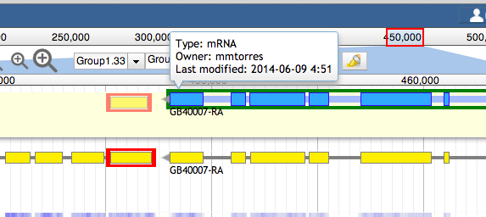
Adding exons
Select and drag the putative new exon from a track, and add it directly to an annotated transcript in the ‘User-created Annotations’ area.
Click the exon, hold your finger on the mouse button, and drag the cursor until it touches the receiving transcript. A dark green highlight indicates it is okay to release the mouse button.
When released, the additional exon becomes attached to the receiving transcript.
A confirmation box will warn you if the receiving transcript is not on the same strand as the feature where the new exon originated.
40

Slide 41
Adding exons
Each time you add an exon region, whether by extension or adding an exon, Web Apollo recalculates the longest ORF, identifying ‘Start’ and ‘Stop’ signals and allowing you to determine whether a ‘Stop’ codon has been incorporated after each editing step.
Web Apollo demands that an exon already exists as an evidence in one of the tracks. You could provide a text file in GFF format and select File → Open. GFF is a simple text file delimited by TABs, one line for each genomic ‘feature’: column 1 is the name of the scaffold; then some text (irrelevant), then ‘exon’, then start, stop, strand as + or -, a dot, another dot, and Name=some name
Example:
scaffold_88 Qratore exon 21 2111 + . . Name=bob
scaffold_88 Qratore exon 2201 5111 + . . Name=rad
41

Slide 42
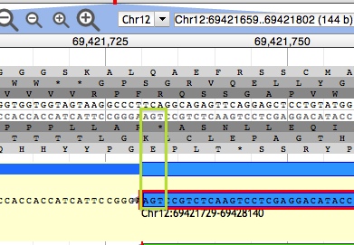
Adding UTRs
Gene predictions may or may not include UTRs. If transcript alignment data are available and extend beyond your original annotation, you may extend or add UTRs.
Position the cursor at the beginning of the exon that needs to be extended and ‘Zoom to base level’.
Place the cursor over the edge of the exon until it becomes a black arrow then click and drag the edge of the exon to the new coordinate position that includes the UTR.
View zoomed to base level. The DNA track and annotation track are visible. The DNA track includes the sense strand (top) and anti-sense strand (bottom). The six reading frames flank the DNA track, with the three forward frames above and the three reverse frames below. The User-created Annotation track shows the terminal end of an annotation. The green rectangle highlights the location of the nucleotide residues in the ‘Stop’ signal.
To add a new spliced UTR to an existing annotation follow the procedure for adding an exon.
42

Slide 43
Exon structure integrity
Zoom in sufficiently to clearly resolve each exon as a distinct rectangle.
Two exons from different tracks sharing the same start and/or end coordinates, will display a red bar to indicate the matching edges.
Selecting the whole annotation or one exon at a time, use this ‘edge-matching’ function and scroll along the length of the annotation, verifying exon boundaries against available data. Use square [ ] brackets to scroll from exon to exon.
Note if there are cDNA / RNAseq that lack one or more of the annotated exons or include additional exons.
43

Slide 44
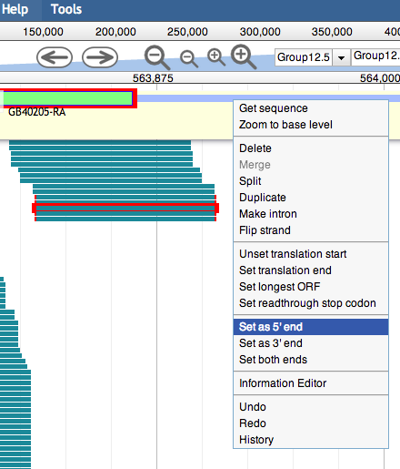
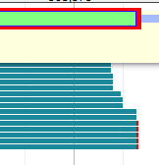
Exon structure integrity
To modify an exon boundary and match data in the evidence tracks: select both the offending exon and the feature with the expected boundary, then right click on the annotation to select ‘Set 3’ end’ or ‘Set 5’ end’ as appropriate.
In some cases all the data may disagree with the annotation, in other cases some data support the annotation and some of the data support one or more alternative transcripts. Try to annotate as many alternative transcripts as are well supported by the data.
44

Slide 45
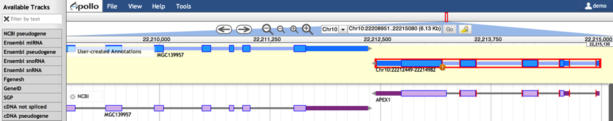
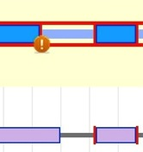
Editing Logic
The editing logic in the server:
selects longest ORF as CDS
flags non-canonical splice sites
‘User-created Annotations’ Track
Evidence Tracks Area
Flags non-canonical splice sites.
Selection of features and sub-features
Edge-matching

Slide 46
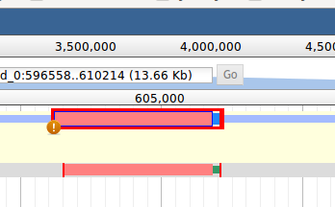
Splice sites
Curated model
Zoom to base level to review non-canonical splice site warnings. These do not necessarily need to be corrected, but should be flagged with the appropriate comment.
Exon/intron junction possible error
Original model
Non-canonical splices are indicated by an orange circle with a white exclamation point inside, placed over the edge of the offending exon.
Most insects, have a valid non-canonical site GC-AG. Other non-canonical splice sites are unverified. Web Apollo flags GC splice donors as non-canonical.
Canonical splice sites:
forward strand
5’-…exon]GT / AG[exon…-3’
reverse strand, not reverse-complemented:
3’-…exon]GA / TG[exon…-5’
46

Slide 47
Splice sites (keep this in mind)
Some gene prediction algorithms do not recognize GC splice sites, thus the intron/exon junction may be incorrect. For example, one such gene prediction algorithm may ignore a true GC donor and select another non-canonical splice site that is less frequently observed in nature.
Therefore, if upon inspection you find a non-canonical splice site that is rarely observed in nature, you may wish to search the region for a more frequent in-frame non-canonical splice site, such as a GC donor. If there is an in-frame site close that is more likely to be the correct splice donor, you may make this adjustment while zoomed at base level.
Curated model
Exon/intron junction possible error
Original model
Canonical splice sites:
forward strand
5’-…exon]GT / AG[exon…-3’
reverse strand, not reverse-complemented:
3’-…exon]GA / TG[exon…-5’
Use RNA-Seq data to make a decision.
47

Slide 48
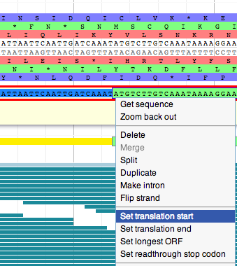
‘Start’ and ‘Stop’ sites
Web Apollo calculates the longest possible open reading frame (ORF) that includes canonical ‘Start’ and ‘Stop’ signals within the predicted exons.
If it appears to have calculated an incorrect ‘Start’ signal, you may modify it selecting an in-frame ‘Start’ codon further up or downstream, depending on evidence (protein database, additional evidence tracks). An upstream ‘Start’ codon may be present outside the predicted gene model, within a region supported by another evidence track.
48

Slide 49
‘Start’ and ‘Stop’ sites (keep in mind)
Note that the ‘Start’ codon may also be located in a non-predicted exon further upstream. If you cannot identify that exon, add the appropriate note in the transcript’s ‘Comments’ section.
In very rare cases, the actual ‘Start’ codon may be non-canonical (non-ATG).
In some cases, a ‘Stop’ codon may not be automatically identified. Check to see if there are data supporting a 3’ extension of the terminal exon or additional 3’ exons with valid splice sites.
49

Slide 50
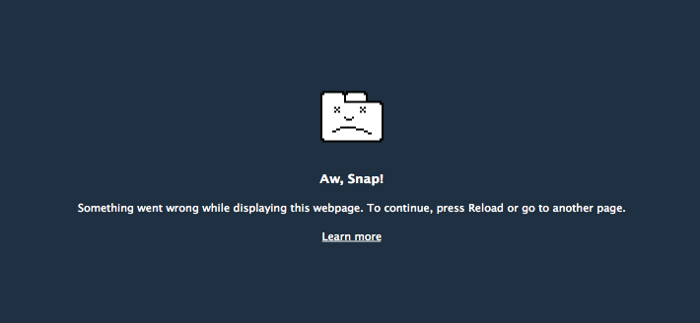

Slide 51
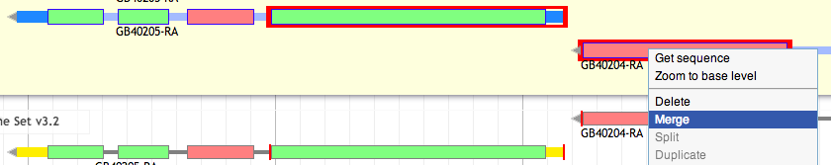
Complex Cases:
Merge two gene predictions on the same scaffold
Evidence may support joining two or more different gene models. Warning: protein alignments may have incorrect splice sites and lack non-conserved regions!
Drag and drop each gene model to ‘User-created Annotations’ area. Shift click to select an intron from each gene model and right click to select the ‘Merge’ option from the menu.
Drag supporting evidence tracks over the candidate models to corroborate overlap, or review edge matching and coverage across models.
Check the resulting translation by querying a protein database e.g. UniProt. Record the IDs of both starting gene models in ‘DBXref’ and add comments to record that this annotation is the result of a merge.
Red lines around exons:
‘edge-matching’ allows annotators to confirm whether the evidence is in agreement without examining each exon at the base level.
51

Slide 52
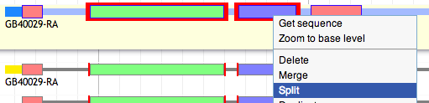
Complex Cases: Split a gene prediction
One or more splits may be recommended when different segments of the predicted protein align to two or more different families of protein homologs, and the predicted protein does not align to any known protein over its entire length. Transcript data may support a split (if so, verify that it is not a case of alternative transcripts).
52

Slide 53
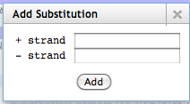
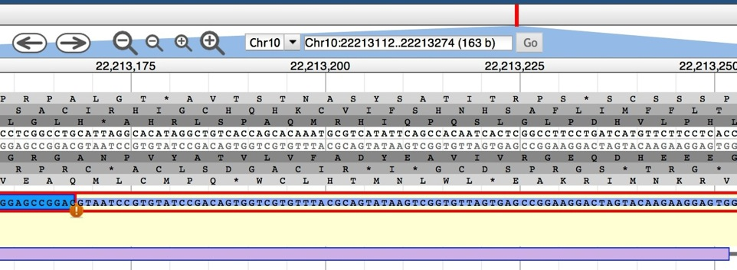
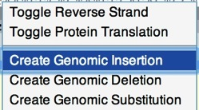
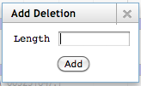
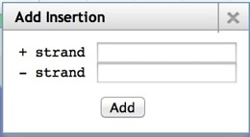
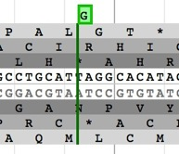
Complex Cases: Frameshifts, single-base errors, and selenocysteines
DNA Track
‘User-created Annotations’ Track

Slide 54
Complex Cases: Frameshifts, single-base errors, and selenocysteines
Web Apollo allows annotators to make single base modifications or frameshifts that are reflected in the sequence and structure of any transcripts overlapping the modification. Note that these manipulations do NOT change the underlying genomic sequence.
If you determine that you need to make one of these changes, zoom in to the nucleotide level and right click over a single nucleotide on the genomic sequence to access a menu that provides options for creating insertions, deletions or substitutions.
The ‘Create Genomic Insertion’ feature will require you to enter the necessary string of nucleotide residues that will be inserted to the right of the cursor’s current location. The ‘Create Genomic Deletion’ option will require you to enter the length of the deletion, starting with the nucleotide where the cursor is positioned. The ‘Create Genomic Substitution’ feature asks for the string of nucleotide residues that will replace the ones on the DNA track.
Once you have entered the modifications, Web Apollo will recalculate the corrected transcript and protein sequences, which will appear when you use the right-click menu ‘Get Sequence’ option. Since the underlying genomic sequence is reflected in all annotations that include the modified region you should alert the curators of your organisms database using the ‘Comments’ section to report the CDS edits.
In special cases such as selenocysteine containing proteins (read-throughs), right-click over the offending/premature ‘Stop’ signal and choose the ‘Set readthrough stop codon’ option from the menu.
54

Slide 55
Completing the annotation
Follow our checklist until you are happy with the annotation!
Then:
Comment to validate your annotation, even if you made no changes to an existing model. Your comments mean you looked at the curated model and are happy with it; think of it as a vote of confidence.
Or add a comment to inform the community of unresolved issues you think this model may have.
Always Remember: Web Apollo curation is a community effort so please use comments to communicate the reasons for your annotation (your comments will be visible to everyone).
55

Slide 56
Checklist for Accuracy and Integrity
Can you add UTRs (e.g.: via RNA-Seq)?
Check exon structures
Check splice sites: most splice sites display these residues …]5’-GT/AG-3’[…
Check ‘Start’ and ‘Stop’ sites
Check the predicted protein product(s)
Align it against relevant genes/gene family.
blastp against NCBI’s RefSeq or nr
If the protein product still does not look correct then check:
Are there gaps in the genome?
Merge of 2 gene predictions on the same scaffold
Merge of 2 gene predictions from different scaffolds
Split a gene prediction
Frameshifts
error in the genome assembly?
Selenocysteine, single-base errors, and other inconvenient phenomena
Finalize annotation by adding:
Important project information in the form of canned and/or customized comments
IDs from GenBank (via DBXRef), gene symbol(s), common name(s), synonyms, top BLAST hits (with GenBank IDs), orthologs with species names, and everything else you can think of, because you are the expert.
Whether your model replaces one or more models from the official gene set (so it can be deleted).
The kinds of changes you made to the gene model of interest, if any. E.g.: splits, merges, whether the 5’ or 3’ ends had to be modified to include ‘Start’ or ‘Stop’ codons, additional exons had to be added, or non-canonical splice sites were accepted.
Any functional assignments that you think are of interest to the community (e.g. via BLAST, RNA-Seq data, literature searches, etc.)
56

Slide 57
Exercises
Live Demonstration using the Apis mellifera genome.
1. Evidence in support of protein coding gene models.
1.1 Consensus Gene Sets:
Official Gene Set v3.2
Official Gene Set v1.0
1.2 Consensus Gene Sets comparison:
OGSv3.2 genes that merge OGSv1.0 and
RefSeq genes
OGSv3.2 genes that split OGSv1.0 and RefSeq genes
1.3 Protein Coding Gene Predictions Supported by Biological Evidence:
NCBI Gnomon
Fgenesh++ with RNASeq training data
Fgenesh++ without RNASeq training data
NCBI RefSeq Protein Coding Genes and Low Quality Protein Coding Genes
1.4 Ab initio protein coding gene predictions:
Augustus Set 12, Augustus Set 9, Fgenesh, GeneID, N-SCAN, SGP2
1.5 Transcript Sequence Alignment:
NCBI ESTs, Apis cerana RNA-Seq, Forager Bee Brain Illumina Contigs, Nurse Bee Brain Illumina Contigs, Forager RNA-Seq reads, Nurse RNA-Seq reads, Abdomen 454 Contigs, Brain and Ovary 454 Contigs, Embryo 454 Contigs, Larvae 454 Contigs, Mixed Antennae 454 Contigs, Ovary 454 Contigs
Testes 454 Contigs, Forager RNA-Seq HeatMap, Forager RNA-Seq XY Plot, Nurse RNA-Seq HeatMap, Nurse RNA-Seq XY Plot

Slide 58
Exercises
Live Demonstration using the Apis mellifera genome.
1. Evidence in support of protein coding gene models (Ctd).
1.6 Protein homolog alignment:
Acep_OGSv1.2
Aech_OGSv3.8
Cflo_OGSv3.3
Dmel_r5.42
Hsal_OGSv3.3
Lhum_OGSv1.2
Nvit_OGSv1.2
Nvit_OGSv2.0
Pbar_OGSv1.2
Sinv_OGSv2.2.3
Znev_OGSv2.1
Metazoa_Swissprot
2. Evidence in support of non protein coding gene models
2.1 Non-protein coding gene predictions:
NCBI RefSeq Noncoding RNA
NCBI RefSeq miRNA
2.2 Pseudogene predictions:
NCBI RefSeq Pseudogene

Slide 59
Web Apollo Workshop Instances
http://genomes.missouri.edu:8080/Amel_4.5_demo_1
http://genomes.missouri.edu:8080/Amel_4.5_demo_2 Workshop Documentation at https://uofi.box.com/webapollo

Slide 60
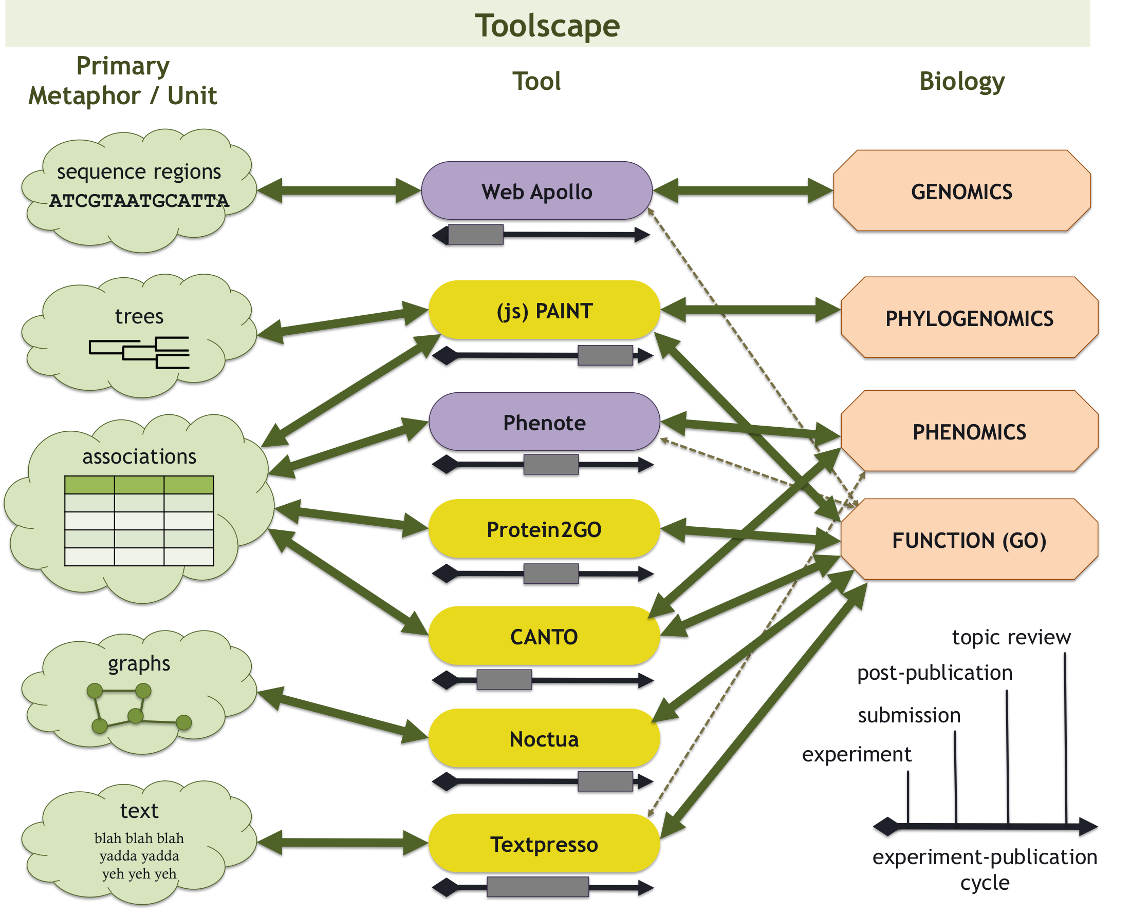
Improving Genomic Annotation and Curation

Slide 61

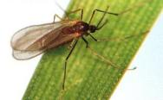
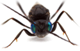
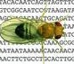

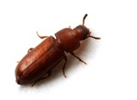
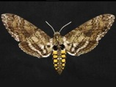
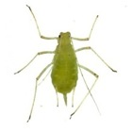
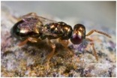
Arthropodcentric Thanks!
AgriPest Base
FlyBase
Hymenoptera Genome Database
VectorBase
Acromyrmex echinatior
Acyrthosiphon pisum
Apis mellifera
Atta cephalotes
Bombus terrestris
Camponotus floridanus
Helicoverpa armigera
Linepithema humile
Manduca sexta
Mayetiola destructor
Nasonia vitripennis
Pogonomyrmex barbatus
Solenopsis invicta
Tribolium castaneum…and many more!
61

Slide 62
Thanks!
Berkeley Bioinformatics Open-source Projects (BBOP), Berkeley Lab: Web Apollo and Gene Ontology teams. Suzanna E. Lewis (PI).
Christine G. Elsik (PI). § University of Missouri.
Ian Holmes (PI). * University of California Berkeley.
Arthropod genomics community: i5K Steering Committee, Alexie Papanicolaou at CSIRO, Monica Poelchau at USDA/NAL, fringy Richards at HGSC-BCM, BGI, Oliver Niehuis at 1KITE http://www.1kite.org/, and the Honey Bee Genome Sequencing Consortium.
Web Apollo is supported by NIH grants 5R01GM080203 from NIGMS, and 5R01HG004483 from NHGRI, and by the Director, Office of Science, Office of Basic Energy Sciences, of the U.S. Department of Energy under Contract No. DE-AC02-05CH11231.
Insect images used with permission: http://AlexanderWild.com and O. Niehuis.
For your attention, thank you!
BBOP
Web Apollo
Gregg Helt
Ed Lee
Colin Diesh §
Deepak Unni §
Rob Buels *
Gene Ontology
Chris Mungall
Seth Carbon
Heiko Dietze
Web Apollo: http://GenomeArchitect.org
GO: http://GeneOntology.org
i5K: http://arthropodgenomes.org/wiki/i5K
Notes:
Thank you!

